Slide 1

SACSSP NEW ONLINE REGISTRATION SYSTEM POWERED BY GLUE UP
SOUTH AFRICAN
COUNCIL FOR SOCIAL SERVICE PROFESSIONS
Mr Hitler Sekhitla
REGISTRAR
28 October 2025
PHSDSBC
NON NOBIS – Not For Ourselves

Slide 2

GLUE UP SYSTEM
It is an off-the shelve, integrated, all-in-one platform designed to provide faster, smarter and secure services.
It is a fully developed system. It allows for configuration according to a client’s needs.
South African Council for Social Service Professions

Slide 3
FUNCTIONS
The system is efficient and user-friendly:
24/7 access
Mobile App
Faster processing of applications (online registration and renewals)
Ability to make online payments of registration and annual fees (DPO pay)
Secure environment to upload documents
Instant access to registration certificate, practice card and seal
Live updates
Website integration
Access to SACSSP events and CPD trainings
Access to Membership Directory
Interacting with other Social Service Professionals inside the community platform
South African Council for Social Service Professions

Slide 4
HOW TO ACCESS THE SYSTEM
Web browser (Google Chrome, Microsoft Edge, Safari) https://sacssp.glueup.com/register/account
SACSSP Website www.sacssp.co.za (Click login or Register)
Mobile App (Google Play Store/Apple Store)
South African Council for Social Service Professions

Slide 5

UPDATING PARTICULARS
Scan the QR to complete the Microsoft
Form.
It takes less than 2min to complete and
provide the following information:
Name & surname
ID number
Personal email address
SACSSP registration number
Professional category
Cellphone number
Province
South African Council for Social Service Professions

Slide 6
SACSSP ONLINE REGISTRATION SYSTEM
On the new online registration system, you can:
1. Create your account
2. Update your profile
Update your personal and professional details
3. Apply for registration
Upload required documents
Instant registration certificate-direct access to digital certificates upon approval.
Instant practice card-upon payment of the annual fee through the online payment method
4. Make payments securely
5. Renew your registration
6. Track SACSSP events (instant access to SACSSP events and CPD activities).
7. Access important notices and documents from SACSSP.
8. Membership Directory
Interact with social service professionals on professional and practice matters.
Verify if a person is registered with the SACSSP or not.
South African Council for Social Service Professions

Slide 7
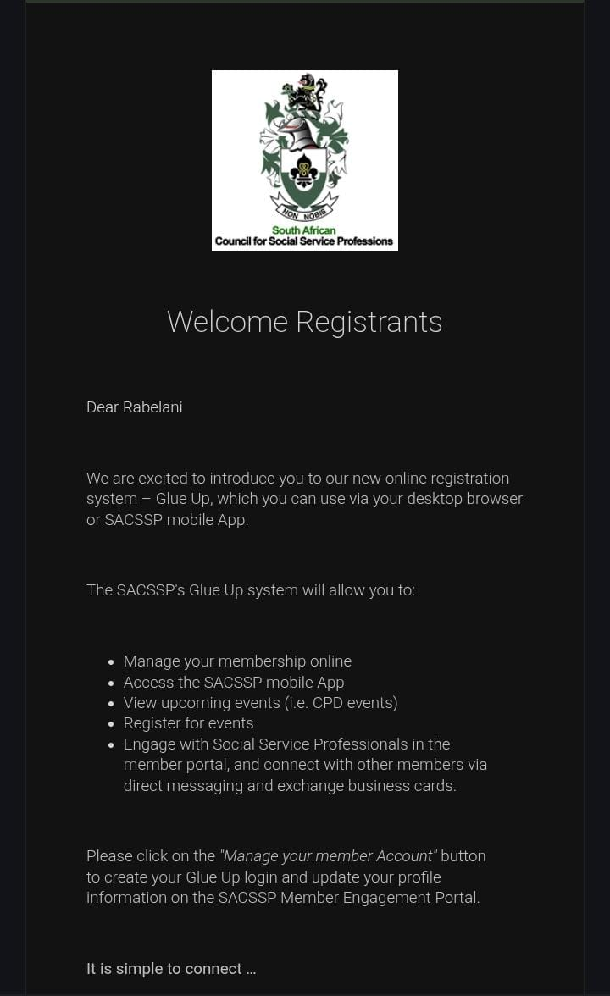
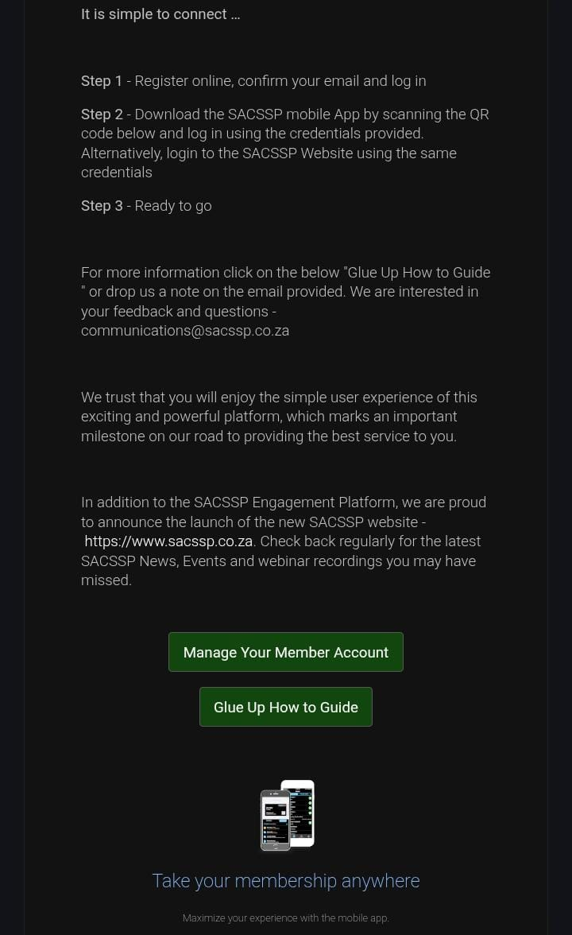
ONLINE REGISTRATION WELCOME EMAIL
South African Council for Social Service Professions

Slide 8
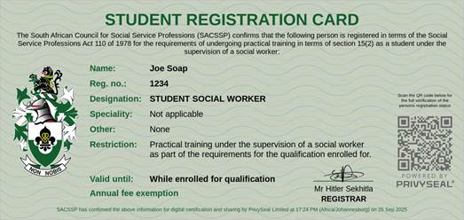
NEW DIGITAL PRACTICE CARD
South African Council for Social Service Professions

Slide 9
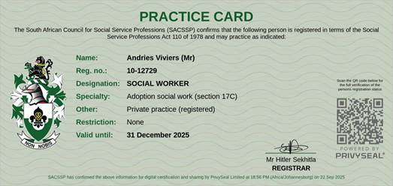
NEW DIGITAL PRACTICE CARD
South African Council for Social Service Professions

Slide 10
IMPACT ON IMPLEMENTATION OF RESOLUTION 3 OF 2019
The current arrangement of submission of lists by employers for verification and bulk payments will remain in place.
The SACSSP will capture the payments manually and active SSPs to access practice cards
SSPs will receive email notifications as soon as membership gets activated.
South African Council for Social Service Professions

Slide 11
PROVINCIAL WEBINARS
The SACSSP will be rolling out provincial webinars as follows;
Visit the website (www.sacssp.co.za) to register for attendance
Province | Date | Time
Eastern Cape | 31 October 2025 | 09h00-12h00
Free State | 05 November 2025 | 09h00-12h00
Gauteng | 07 November 2025 | 09h00-12h00
KwaZulu Natal | 12 November 2025 | 09h00-12h00
Limpopo | 14 November 2025 | 09h00-12h00
Mpumalanga | 19 November 2025 | 09h00-12h00
Northern Cape | 21 November 2025 | 09h00-12h00
North West | 26 November 2025 | 09h00-12h00
Western Cape | 28 November 2025 | 09h00-12h00
South African Council for Social Service Professions

Slide 12
WAYFORWARD
We kindly request the PHSDSBC and the parties to mobilise Social Service Professionals to:
1. participate in the completion of the Microsoft Form.
2. Register and attend provincial webinars.
We further request employers to:
update the verification lists to add the columns for email
address (personal email address) and cellphone number.
(b) convene provincial/regional/district or workplace webinars
or face-to-face workshop and invite the SACSSP to train
SSPs on the new Online Registration System.
South African Council for Social Service Professions

Slide 13

SOUTH AFRICAN
COUNCIL FOR SOCIAL SERVICE PROFESSIONS
37 Annie Botha Avenue, Riviera, Pretoria, 0084 / Private Bag X12, Gezina, 0031, Republic of Sout Africa
Telephone: +27 12 356 8300
Website: http://www.sacssp.co.za
Twitter: @sacssp1 Facebook:@OfficialSACSSP
Thank you
NON NOBIS – Not For Ourselves

